Slide 1
Chapter 11 Maintaining Wellness and Relationships in a Diverse World

Slide 2
Assess Your Strengths and Set Goals
Maintaining your healthy in college will enable you to feel good about yourself and succeed academically.
Think about challenges you have had in the past in the areas of health, wellness, and relationships. Think of reasonable goals you would like to achieve.

Slide 3

Understanding Wellness
Wellness is a concept that encompasses care of mind, body, and spirit. Components of wellness:
Managing stress
Paying attention to diet and nutrition
Saying “no” when you need to
What are the other components of wellness?
Notes:
Other components of wellness include:
Seeking help for emotional problems
Remembering to exercise
Getting enough sleep
Maintaining your sexual health
Avoiding substance abuse
Achieving balance

Slide 4

http://drive.google.com/file/d/1XnNulJlPEhn7M-Vy72QR27TWPmHiitCo/view

Slide 5
Managing Stress to Maintain Wellness
Physiological changes caused by stress
Rapid and shallow breathing
Upset stomach
Psychological changes caused by stress
Bad decision making
Emotions such as anger, anxiety, depression, fear, frustration, and irritability
Stress-related changes: can turn into anxiety disorder, depression, or panic attacks
Notes:
Other physiological changes:
Dry mouth
Strained voice
Increased heart rate
Tightening of muscles
Sweaty or cold hands
Shaking hands or knees
Other psychological changes:
Trouble concentrating
Memory lapses
Poor problem solving
Confusion

Slide 6
Sources of Stress
Life events
Death of a parent, spouse, partner, or friend
Daily hassles
Losing your keys
Having three tests on the same day
Quarreling with your roommate
Worrying about money

Slide 7
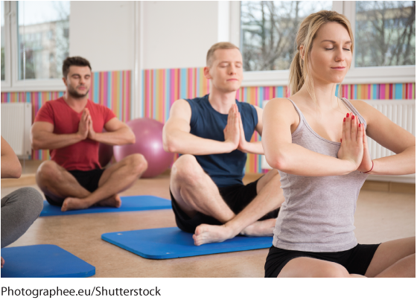
Take Control
The best starting point is to be in good physical and mental shape.
Identify parts of your life that do not serve you well and make plans for change.
Know your boundaries and make priority lists.
Manage your obligations.
Say “no” to friends and family when necessary.

Slide 8
The Importance of Good Nutrition
Clear connections between what you eat and drink, your overall well-being, and stress
Caffeine
Increases alertness and reduces fatigue if used moderately
Excessive amounts can cause nervousness, headaches, irritability, upset stomach, and sleeplessness

Slide 9

Make Good Choices
Limit snacks to healthy options.
Be careful about “fad” diets.
Drink plenty of water.
Have your eating habits changed since you started college?

Slide 10
Risky Eating Habits
The key to good health is achieving balance. Obsession with food intake may indicate loss of balance.
Instances of eating disorders have risen in male and female college students.
Anyone struggling with an eating disorder should seek immediate medical attention.

Slide 11

Alcohol and Other Substances
To avoid potential legal consequences, do not drink alcohol under age twenty-one.
Harm-reduction approaches:
Slow down drinking.
Eat while you drink.
Drink water.
Designate a driver before you go out.

Slide 12
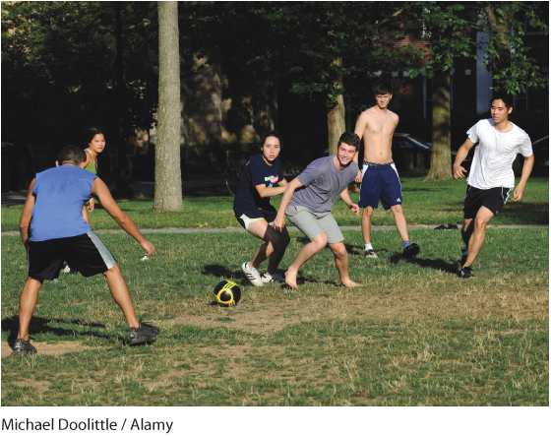
Exercising to Maintain Wellness
Excellent stress-management technique
Be outside and active every day
Important to choose activities that you enjoy
Leads to higher energy levels, less stress, better sleep, healthier weight, and improved self-image
Notes:
Other things to note about exercise:
Aerobic exercise keeps your mind healthy.
Think about ways to combine activities and use your time efficiently.
Be aware of your body mass index (BMI).

Slide 13

Getting Enough Sleep to Maintain Wellness
Getting adequate sleep is a way to protect yourself from stress.
Avoid long daytime naps.
Get everything you need for the next day ready before you go to bed.
Stick to a regular sleep schedule.
Do you think you are getting enough sleep?
Notes:
Other tips about maintaining a healthy sleep pattern include:
Before bed, try reading or listening to a relaxation tape.
Exercise during the day.
Sleep in the same room and bed every night.

Slide 14
Spirituality
Spirituality is a broad term that includes religion and an exploration of questions about life’s meaning and ultimate values.
Can be linked to attendance at church, temple, mosque, or synagogue
Can be explored through meditation, yoga, or a strong connection to nature or art
Maintenance will help you achieve a healthy perspective

Slide 15
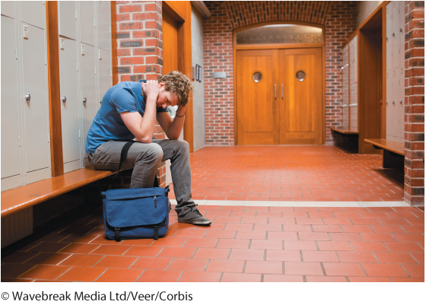
Emotional Health
Emotional or mental health are important to overall health.
Ability to deal with life’s challenges based on emotional intelligence (EI)
When emotional health declines, the consequences can be very serious.
Why are college students especially at risk for depression and suicide?
Notes:
Instructors: Use the question in the slide to generate class discussion about emotional health and college students.

Slide 16
Depression
Depression is not a weakness; it is an illness that needs medical attention. Some symptoms include:
Feelings of helplessness and hopelessness
Feeling useless, inadequate, bad, or guilty
Difficulty sleeping or excessive need for sleep
Notes:
Other symptoms of depression include:
Self-hatred
Loss of energy and motivation
Loss of appetite
Weight loss or gain
Loss of interest in sex
Difficulty concentrating

Slide 17
Suicide
Some common indicators include:
Recent loss and inability to let go of grief
Change in personality—sadness, withdrawal, indifference
Expressions of self-hatred
Direct statement about committing suicide
Notes:
Other indicators include:
Change in sleep patterns
Change in eating habits
Preoccupation with death

Slide 18
Cyberbulling
“Any behavior performed through electronic or digital media by individuals or groups who repeatedly communicate hostile or aggressive messages intended to inflict harm or discomfort on others”¹
Serious issue that harms individuals in many ways
Crime that should be dealt with immediately
Instances of cyberbullying: report as soon as possible
¹ P. K. Smith et al., “Cyberbullying: Its Nature and Impact in Secondary School Pupils,” Journal of Child Psychology and Psychiatry, no. 49 (2008), 375-376.

Slide 19
Seek Help
If you or someone you know displays signs of depression, suicide, cyberbullying, or other emotional health issues, it is time to consult a mental health professional.

Slide 20
Maintaining Sexual Health
Strategies for communicating about safe sex
Discuss testing for STIs.
Share expectations.
Use protection.
Communicate in “I” statements.

Slide 21
Avoiding Sexually Transmitted Infections (STIs)
There are more than twenty known types of STIs.
Seven are most common on college campuses
HPV linked to cervical cancer
STIs are usually spread through genital contact or mouth-to-mouth.
To avoid STIs and unwanted pregnancies:
Use condoms:
Abstain from sex
Notes:
Some suggestions from the chapter to avoid STIs include:
Leave the light on before intercourse.
Gives an opportunity to notice symptoms of an STI on your partner
Helps with proper condom use

Slide 22
Using Birth Control
Any method should be used correctly and consistently.
Always discuss birth control with your partner.
Use condoms for protection against STIs in addition to your chosen method of pregnancy prevention.
Emergency contraceptive pills can be taken within 72 hours of unprotected intercourse.

Slide 23
Protecting Yourself and Others against Sexual Assault and Violence
Facts about sexual assault and violence
The majority of victims are women.
Alcohol is a factor in nearly 75 percent of incidents.
Many assaults happen during first two weeks of classes.
If you observe a sexual assault or potential sexual assault, make your presence known.
The Campus Save Act requires universities to provide sexual assault, violence, and harassment education to students.

Slide 24
Sexual Assault and Violence
Steps to help a sexual assault victim:
Listen.
Remain empathetic and nonjudgmental.
Keep information private and ensure confidentiality.
What are some other ways you can help a sexual assault victim?
Notes:
Other steps to help include:
Ask the victim how he or she would like to proceed.
Seek out advice from a professional.
Stay in touch and follow up to see if the victim is getting the help needed.

Slide 25
Make the Most of the Learning Relationship
Most instructors are required to keep office hours.
Make an appointment if you need help with a difficult topic, or to discuss a problem.
Instructors who know you well may write you letters of reference when applying to graduate school or for a job.

Slide 26

Personal Relationships
One of the best things about going to college is meeting new people.
You’ll learn as much—or more—from other students as you will from instructors.
You will be exposed to new backgrounds and worldviews.

Slide 27
Romantic Relationships/Marriage
Whether you choose to commit to one serious relationship or keep yourself open to meeting different people, you’ll gown and learn a great deal about yourself and others.
It’s important not to marry before both you and your partner are certain of who you are and what you want.
How much time do you have for relationships? Do you have a plan to balance your relationships and academic responsibilities?

Slide 28
Breaking Up
Breaking up is hard, but if it’s time to end a romantic relationship:
Do it cleanly and calmly.
Explain your feelings and talk them out.
Take the high road.
Why do relationships end? How does being in college affect the way in which relationships start and end?
Notes:
Instructors: Use the question in the slide to generate discussion. Other tips about breaking up include:
Let some time pass.
Be open to emotional support.

Slide 29
Relationship No-Nos
Avoid involvement with someone who is in a “power relationship” with you.
If you date a subordinate and the relationship ends, you might be accused of sexual harassment or be fired or sued.
It’s harder to heal from a breakup with a coworker.

Slide 30
Family Connections
Maintain family relationships throughout your college years.
Marriage and parenting during college:
Can coexist, but is not easy
Need to become an expert at time management
Time for your partner and family: plan as carefully as you schedule work and classes

Slide 31
Parents
Relationships with your parents will change in college.
Communicate with your parents, but make your own decisions.
Be aware of their concerns.
Remember, parents generally mean well.

Slide 32
Where to Go for Help
If you find yourself in the midst of a difficult family or relationship situation, seek help from the school counseling center:

Slide 33
Get Involved
Campus life can help you feel comfortable in the college environment.
Consider your interests and high school activities.
Strike a balance between finding a comfortable niche and challenging yourself to new and different interactions.
Be careful not to overextend yourself with campus activities.

Slide 34

Exploring Diversity
Diversity is the difference in social and cultural identities among people living together. A diverse community has many advantages but it can also be a source of misunderstanding or suspicion.
What kind of diversity do you see in your classroom? What kinds of diversity might exist but can’t be seen?

Slide 35
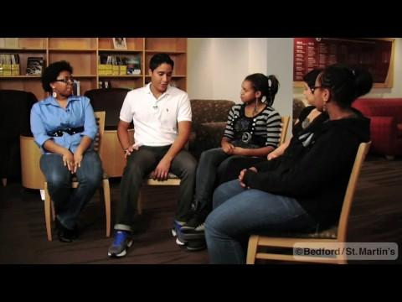
http://drive.google.com/file/d/1N98vXEhTTBE1fq3d3rqNqDaI7cZhbA7R/view
Notes:
Possible discussion starter questions:
Since arriving at college, what are some encounters you have had with completely different cultural rituals or customs?
Jordan says once you talk to him, and see that he reflects neither white nor black cultures, you will see him as more of a person, less of a race. Tell about a time when your first conversation with a person surprised you – the person was different from how you assumed they would be based on your own preconceptions. What happened, or was said, that changed your thoughts about the person?
What are some experiences you have had where you felt proud of your generation, where you felt your generation tolerated/celebrated diversity – in all of its forms – better than previous generations?

Slide 36
Ethnicity
Ethnicity is identity assigned to a specific group of people historically connected by a common national origin or language.
Often the terms ethnicity and culture are used interchangeably, but their definitions are different.

Slide 37
Culture
Culture refers to aspects of a group of people that are passed on or learned.
Examples: traditions, food, language, beliefs

Slide 38
Race
Race refers to shared biological characteristics:
Includes skin tone, hair texture and color, and facial features
Even people who share some biological features—such as similar eye shape or skin color—might be ethnically distinct.

Slide 39
Religion
Religion is a specific, fundamental set of beliefs and practices.
Freedom to practice religion has been central to the American experience.
Whatever your religious views may be, it is important that you respect the views of others.

Slide 40
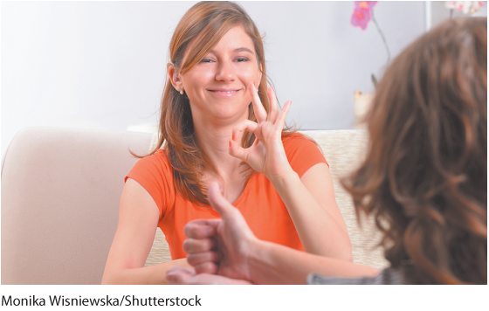
Other Differences
You will experience many other types of diversity in college:
Age
Gender and sex
Economic status
Learning and physical challenges

Slide 41
Stereotyping and Microaggressions
A stereotype is a generalization that is used to describe or distinguish a group.
Microaggressions are subtle but offensive comments that reinforce stereotypes of minority populations.

Slide 42
Meeting People for the First Time
When meeting people for the first time, keep the following suggestions in mind:
Focus on the Person: Put aside previous stereotypes.
Avoid Guesswork: Do not attempt to guess a person’s race, language, diet, expected behavior, age, or knowledge.
Practice the Golden Rule: Treat others as you want to be treated.

Slide 43
Overcoming Discrimination, Prejudice, and Insensitivity on College Campuses
Biases are tendencies against or in favor of certain groups or value systems.
We all have biases but it is what we do with individual beliefs that separates an unbiased and open-minded person from the racist, the bigot, and the extremist.
Hate crimes are crimes motivated by prejudice
Includes physical assault, vandalism, and intimidation

Slide 44
What You Can Do to Fight Hate on Campus
Become involved in making your campus safe.
Work with existing campus services to plan and host training sessions, workshops, and symposiums.
Look into the anti-discrimination measures your college has in place.

Slide 45
Reflection
College offers lots of ways to meet new and interesting people.
Think about profiles on social networking sites. Do you think it is important for college students to be careful about the kinds of information they post on social networking sites?

